Slide 1
CSE2006 – Microprocessor & Interfacing
J-COMPONENT REVIEW-III
Winter 2021-2022
Room Temperature Controller and Home Automation
BATCH NO: 12
GROUP MEMBERS:
1. 20BCE1147 - Kartike Chadha
2. 20BCE1959 - Farhan Arshad
3. 20BCE1514 - Nilashma Saha
Presented to : Prof. B. Chanthini, AP, SENSE, VIT Chennai

Slide 2
OBJECTIVE OF THE PROJECT
In our project we aim to create a utility that is able to remotely control the temperature of a room, open doors and control the lights using an Arduino platform, a PIR sensor, and ultrasonic sensor and a temperature sensor.
The motion sensors will serve to open the door and turn the lights of the room on as the user enters the vicinity of the sensors.
We will regulate the speed of the fan and the heater present in the room to maintain optimum temperature level.
The LEDs and LCD display will indicate the temperature level.

Slide 3
DESIGN PROCESS
Using an arduino, a PIR sensor, an ultrasonic sensor, and a temperature sensor, we will control the door and lights, and regulate the speed of the connected fan and the connected heater to optimize the surrounding temperature levels.
The lights will turn on if any motion is detected, and the door will open if the user enters within a 40 cm radius of the ultrasonic sensor.
The current temperature and humidity level of the room will be displayed by the LCD. The temperature level is denoted by 5 LED lights.
2 red lights will denote too hot, 1 red light will denote hot, green denotes optimum temperature, 1 blue light denotes cold, and 2 blue lights denote freezing cold.

Slide 4
TOOLS REQUIRED
Arduino UNO
Arduino Ethernet Shield
Temperature sensor
PIR sensor
Ultrasonic Distance sensor
Breadboard
Jumper Wires
DC Fan Motor
5 LEDs
LCD Display

Slide 5
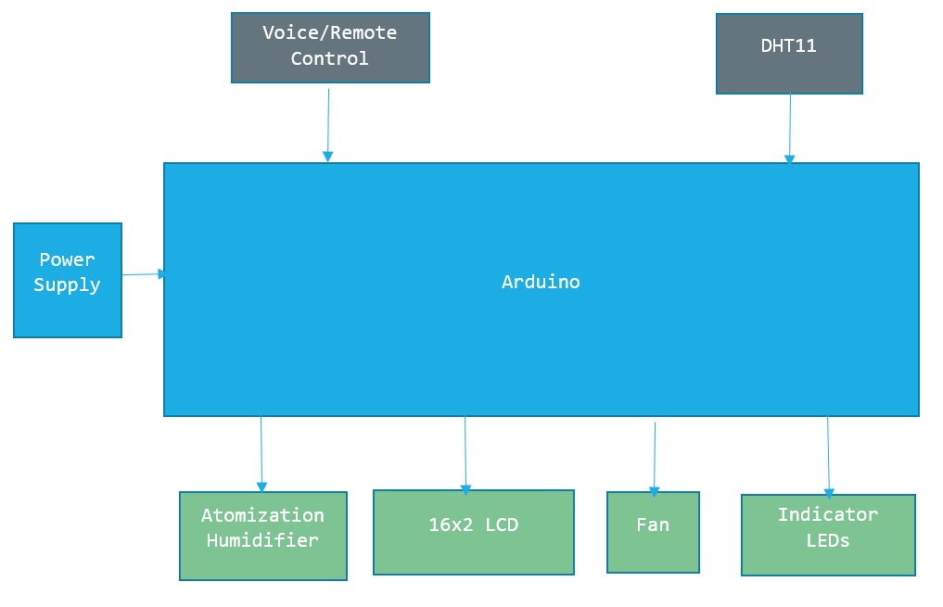
BLOCK DIAGRAM

Slide 6
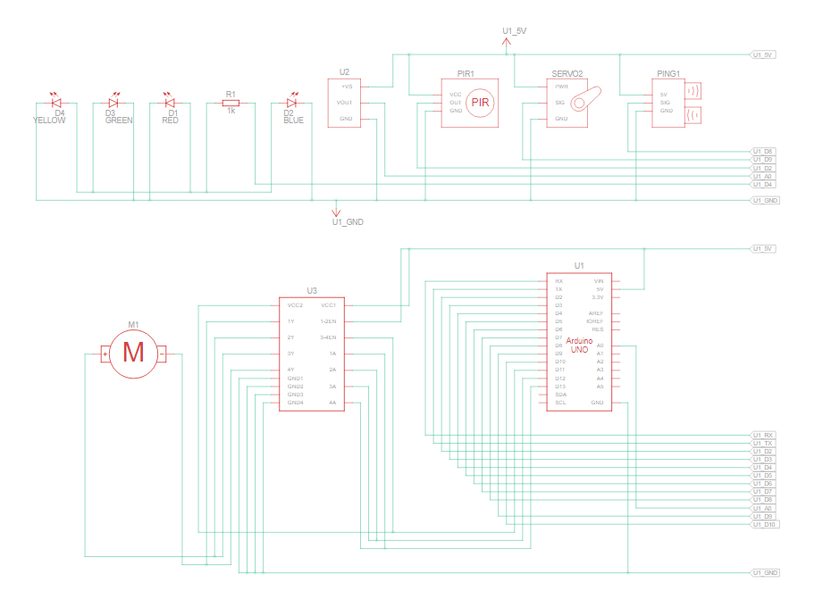
SCHEMATIC DIAGRAM

Slide 7
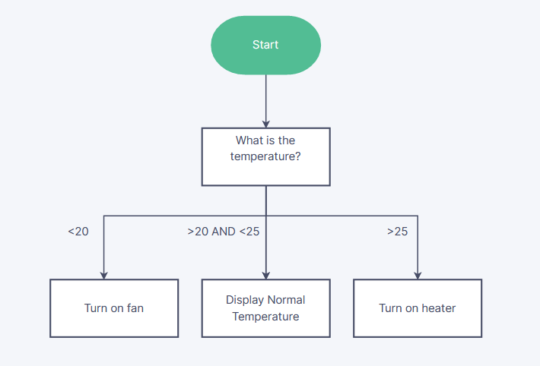
ALGORITHM

Slide 8
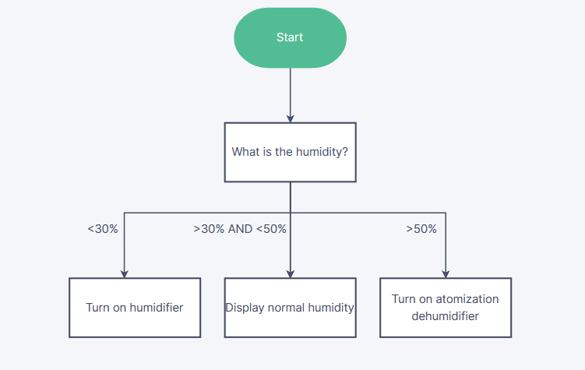
ALGORITHM

Slide 9
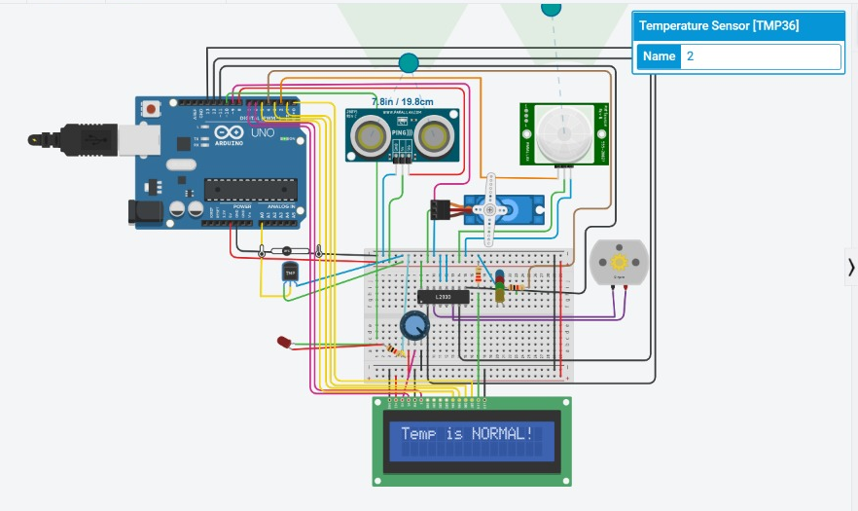
SOFTWARE/HARDWARE IMPLEMENTATION OUTPUT
Temperature is normal

Slide 10
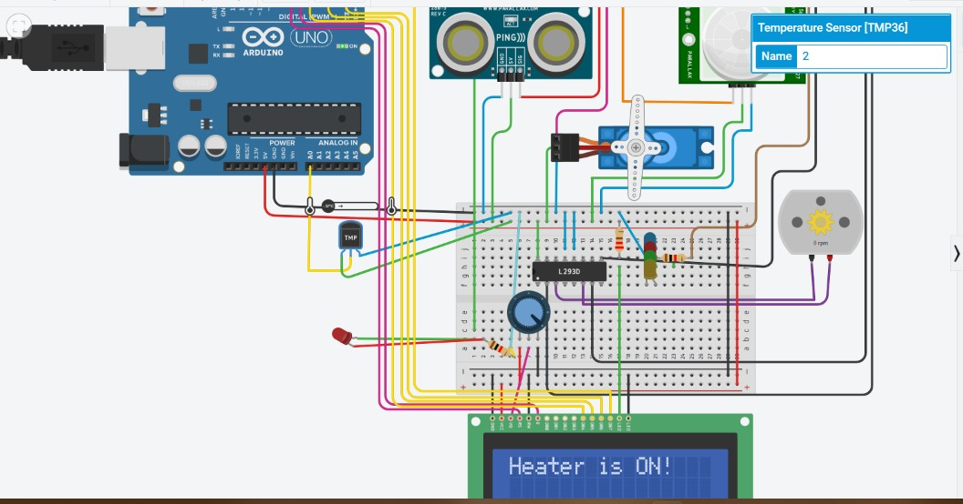
SOFTWARE/HARDWARE IMPLEMENTATION OUTPUT
Temperature is below normal

Slide 11

SOFTWARE/HARDWARE IMPLEMENTATION OUTPUT
Temperature is above normal

Slide 12

SOFTWARE/HARDWARE IMPLEMENTATION OUTPUT
After temperature control

Slide 13

SOFTWARE/HARDWARE IMPLEMENTATION OUTPUT
Opening door

Slide 14
QUESTIONS?

